Slide 1


CMT Paper ID: 210
Towards Smarter Agriculture: Deep Learning-Based Multistage Detection of Leaf Diseases
Authors Name
Dr. S. N. Tirumala Rao,
K. Venkata Ramesh,
B. Surya Prasad,
T. Nagaiah,
Sk Abdul Nabi,
Y. Sravani Devi,
Dr. Sireesha Moturi
Affiliation
Dept. of CSE,
Narasaraopet Engineering College (1,2,3,4,5,7)
Department of Computer Science Engineering,G.Narayanamma Institute of Technology and Science(women), Shaikpet,Hyderabad,Telangana,India(6)
Presented by
Koyyalamudi Venkata Ramesh
Team members details
Bangaru Surya Prasad,
Thullibilli Nagaiah,
Shaik Abdul Nabi
Notes:
1.7.2013
1.7.2013
1.7.2013
1.7.2013
‹#›
‹#›
‹#›
‹#›

Slide 2
Content
❖Introduction
❖Problem Statements
❖Objectives
❖Methodology
❖Result & Discussion
❖Conclusion & Future Scope
❖References
Notes:
1.7.2013
1.7.2013
1.7.2013
1.7.2013
‹#›
‹#›
‹#›
‹#›

Slide 3
Introduction:
Agriculture is very important in India, and many farmers depend on it for their income.
Plant leaf diseases spread quickly and can damage crops, causing big losses.
Identifying these diseases by hand takes time and needs trained experts.
Many farmers do not have access to experts, especially in rural areas.
Early detection of leaf diseases helps in saving crops and improving yield.
Deep learning and computer vision can automatically detect diseases from leaf images.
Modern models like EfficientNet and U-Net give high accuracy even with low-quality images.
This study builds a simple, fast, and accurate system to detect plant leaf diseases and support smarter farming.

Slide 4
Problem Statement:
Farmers find it difficult to identify plant leaf diseases early because symptoms often look similar.
Manual detection is slow, depends on experts, and is not possible in many rural areas.
Existing traditional methods are less accurate and fail under different lighting or weather conditions.
Many deep learning models work well but do not combine both classification and disease-area segmentation.
There is a need for a fast, accurate, and easy-to-use system that can detect and highlight leaf diseases from simple images.

Slide 5
Objectives:
To build an accurate deep learning model that can identify different plant leaf diseases using images.
To improve image quality through preprocessing methods like resizing, normalization, and denoising.
To use EfficientNet-B0 and segmentation techniques to correctly classify diseases and highlight the infected areas.
To create a fast, lightweight, and reliable system that helps farmers detect plant diseases early and protect their crops.

Slide 6
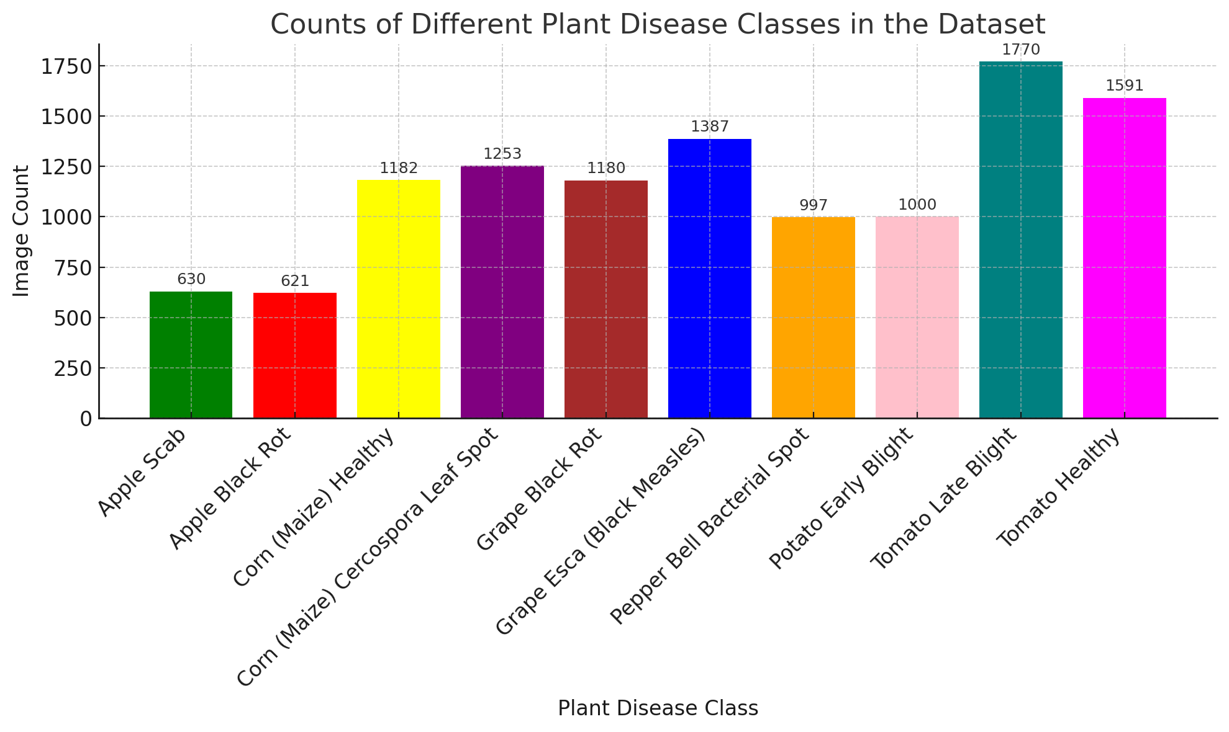
Methodology :
Proposed Explainable Deep Learning Framework
The proposed methodology consists of four major stages:
1️⃣ Data Collection:
Leaf images collected from the PlantVillage dataset.
Contains 89,000 images across 38 plant species and disease types.
Includes both healthy leaves and multiple diseased leaves like blight, mildew, rot, and spots.
Provides a large, diverse, and real-world dataset suitable for training and testing the model.
2️⃣ Data Preprocessing:
Images were resized and cleaned for uniform quality.
Noise was removed, and brightness/contrast were improved.
Duplicate images were removed, and some images were rotated/flipped for more variety.

Slide 7
3️⃣ Data Balancing
The dataset had different numbers of images in each class.
We balanced the data so every class has the same number of images.
This helps the model learn fairly without favoring any class.
4️⃣ Model Development
Preprocessing Module: Improves image quality using resizing, normalization, denoising, and CLAHE.
EfficientNet-B0 Backbone: Extracts deep features from leaf images with high accuracy and low computation.
PCFAN Feature Extractor: Captures detailed patterns and disease spots from the leaf surface.
Segmentation Module (U-Net + Red Fox Optimization): Identifies and highlights the infected regions on the leaf.
Classification Layer: Predicts the disease class based on extracted features.

Slide 8
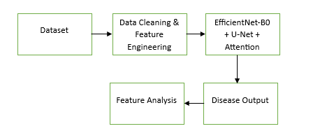
Model Architecture (EfficientNet-B0 + U-Net + Attention):
The proposed model integrates EfficientNet-B0, a U-Net decoder, and an Attention mechanism.
Each component plays a specific role in feature extraction and disease localization::
1️⃣ EfficientNet-B0 Backbone
Extracts important visual features from the leaf images.
Works fast and accurately even with low-resolution data.
2️⃣ PCFAN / Feature Refinement
Enhances small disease patterns and texture details.
Makes the feature maps clearer for better detection.

Slide 9
3️⃣ Attention Module
Focuses on the most important diseased regions of the leaf.
Reduces the effect of background noise and unnecessary details.
4️⃣U-Net Decoder
Produces the accident severity predictiUpsamples the features to produce a detailed segmentation mask.
Shows the exact infected area on the leaf.
5️⃣ Red Fox Optimization
Improves the segmented mask by refining edges and selecting the best disease regions.
6️⃣ Output Layer
Produces both the disease class label and the final segmented infected area.

Slide 10
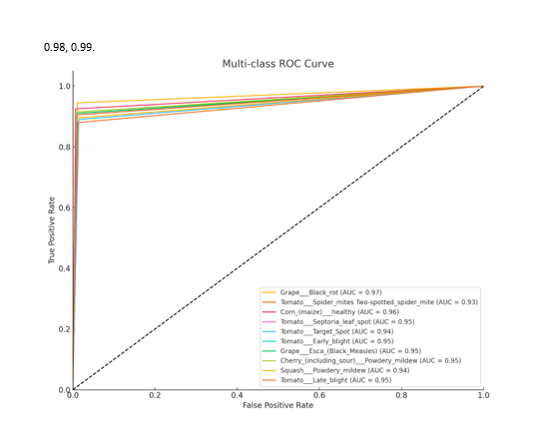
Results and Analysis
The model reaches 97.9% accuracy in detecting leaf diseases.
It correctly identifies most diseases with high precision and recall.
Segmentation clearly highlights the infected areas on each leaf.
Top performing classes include Powdery Mildew, Late Blight, and Septoria Spot.
Even similar-looking diseases are classified correctly with strong confidence.
The results show the model is reliable, accurate, and suitable for real farming use.

Slide 11
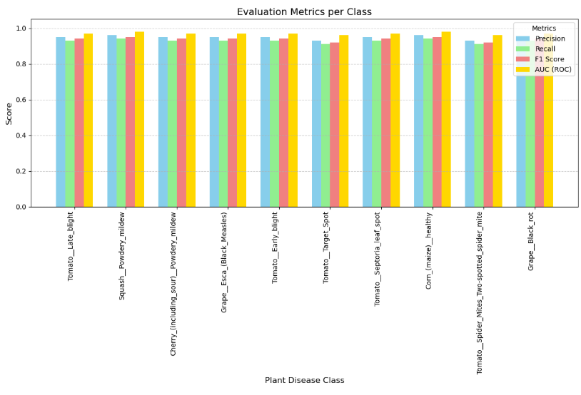
Performance Comparison of Proposed Model
The model shows consistently high scores across all plant disease classes.
Precision, Recall, and F1-score mostly stay above 0.95, proving strong accuracy.
AUC values are close to 1.0, meaning the model is excellent at separating disease types.
Diseases like Powdery Mildew, Spider Mite, and Late Blight achieved the highest scores.
Even visually similar diseases show stable and reliable predictions.
Overall, the graph shows that the proposed model performs uniformly well, without any major drop in any class.

Slide 12
Conclusion
The proposed EfficientNet-B0 and U-Net based model accurately detects various plant leaf diseases.
Preprocessing and attention-based feature refinement improved clarity and helped the model focus on infected regions.
The system achieved high accuracy across all classes, proving reliable for real-world agricultural use.
This model can help farmers identify diseases early, reduce crop loss, and support smarter agriculture.
Future Scope
Integrating the model into a mobile app for real-time field diagnosis.
Expanding the system to detect more crops and additional disease types.
Using drone and IoT integration for large-scale, automated crop monitoring.

Slide 13
References
Kumar et al., “Deep Learning Techniques for Plant Disease Detection,” IEEE Access, 2024.
Joseph et al., “Real-Time Leaf Disease Identification Using CNN Models,” ResearchGate, 2023.
Woo et al., “Deep Semantic Segmentation for Crop Disease Localization,” Springer, 2024.
Patel & Singh, “EfficientNet-Based Classification of Plant Leaf Diseases,” Elsevier, 2023.
Mohanty et al., “Using Deep Learning for Accurate Plant Disease Classification,” arXiv, 2016.
Acknowledgements
We sincerely thank our guide, Dr. S. N. Tirumala Rao,Professor & Head, Department of CSE, for his continuous guidance and encouragement.
We extend our gratitude to the Department of Computer Science and Engineering, Narasaraopeta Engineering College (Autonomous) for providing the necessary support and facilities.
We also thank our friends and family members for their motivation and help throughout the project.
Finally, we would like to thank the INCOWOCO 2025 Conference Committee for giving us the opportunity to present our research work on such a prestigious platform

Slide 14
THANK YOU

